Slide 1
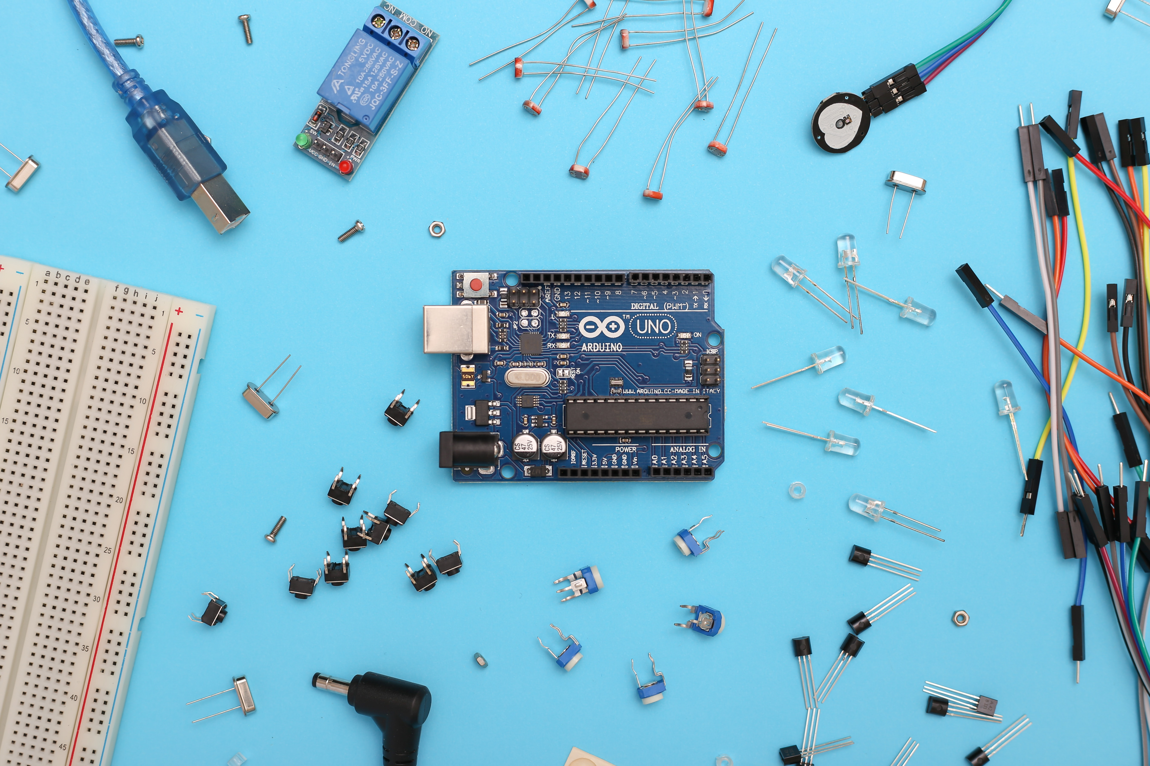
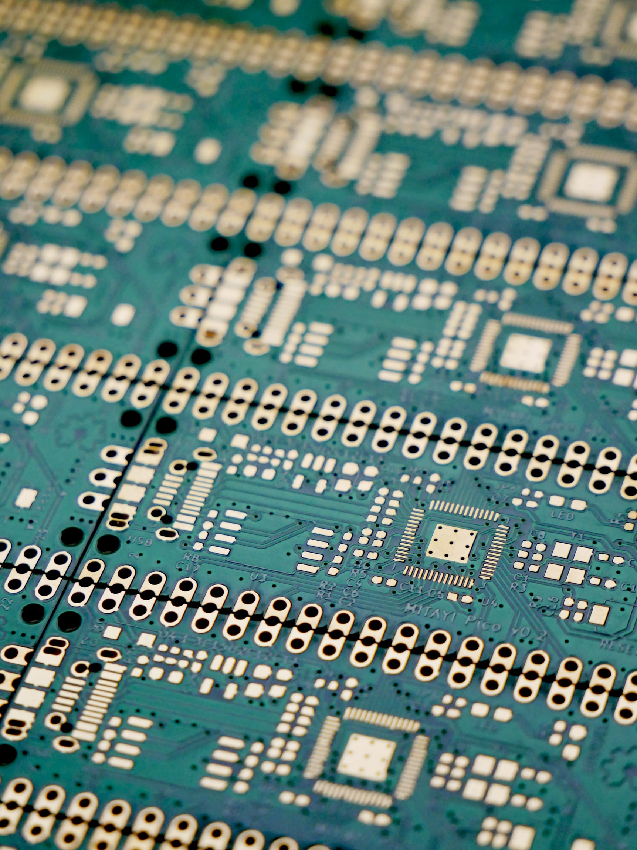
The AVR Microcontrollers:
History and Features
Prepared by 2003021

Slide 2
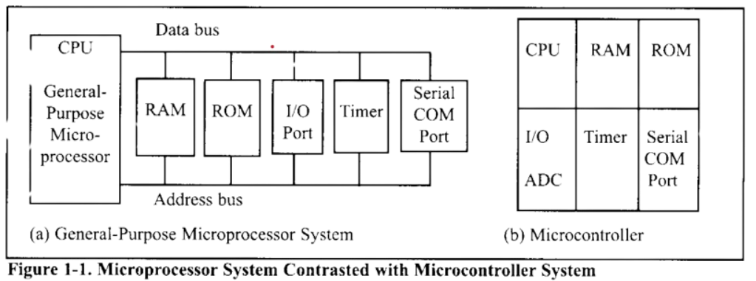
Microcontrollers vs general purpose Microprocessors
General purpose microprocessors doesn’t have in built RAM,ROM or I/O ports. The designer needs to add them additionally to make them functional. On the other hand , Microcontrollers have these things in built so its more specifically usable.
Choosing a Microcontroller
There are 5 major Microcontrollers:
1 -> 68HC08/68HC11 by Motorolla
2 -> Intel’s 8051
3 -> Atmel’s AVR
4 -> Zilog’s Z8
5 -> PIC from Microchip Technology
3 Criteria in choosing Microcontrollers are:
1 => Meeting the computing needs
2 => Availability of tools such as Compilers
3 => Wide availability and reliability

Slide 3


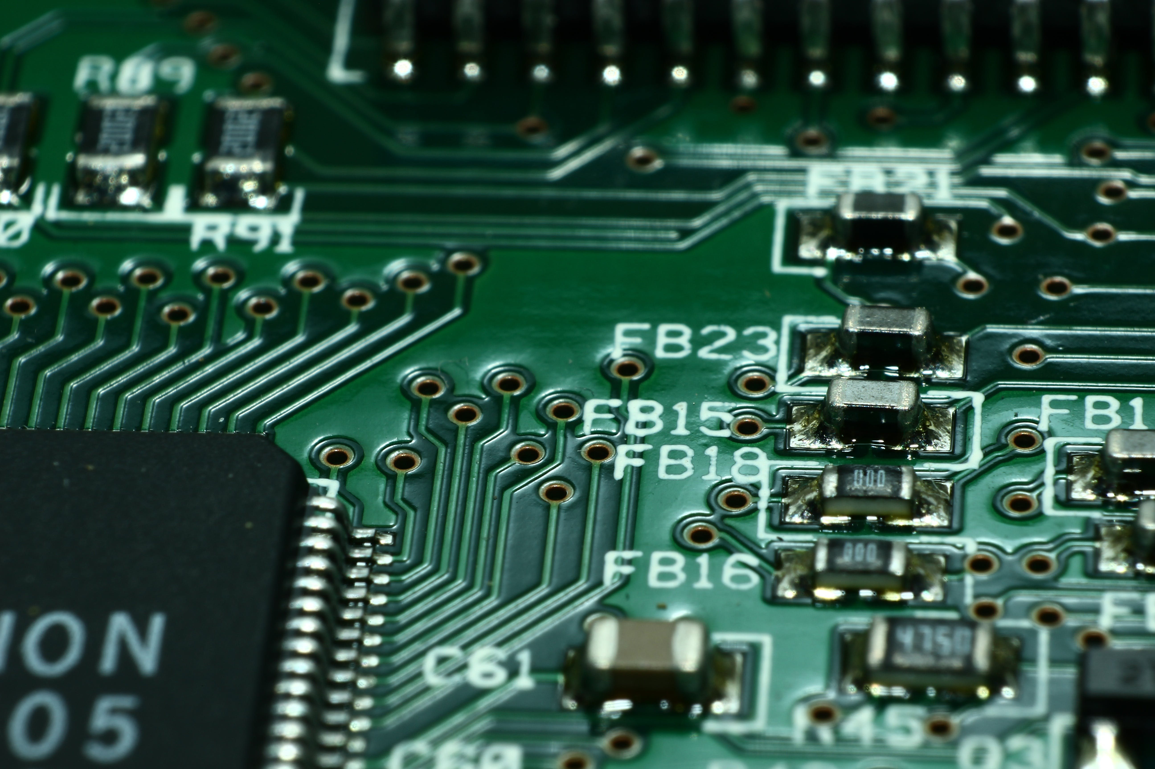
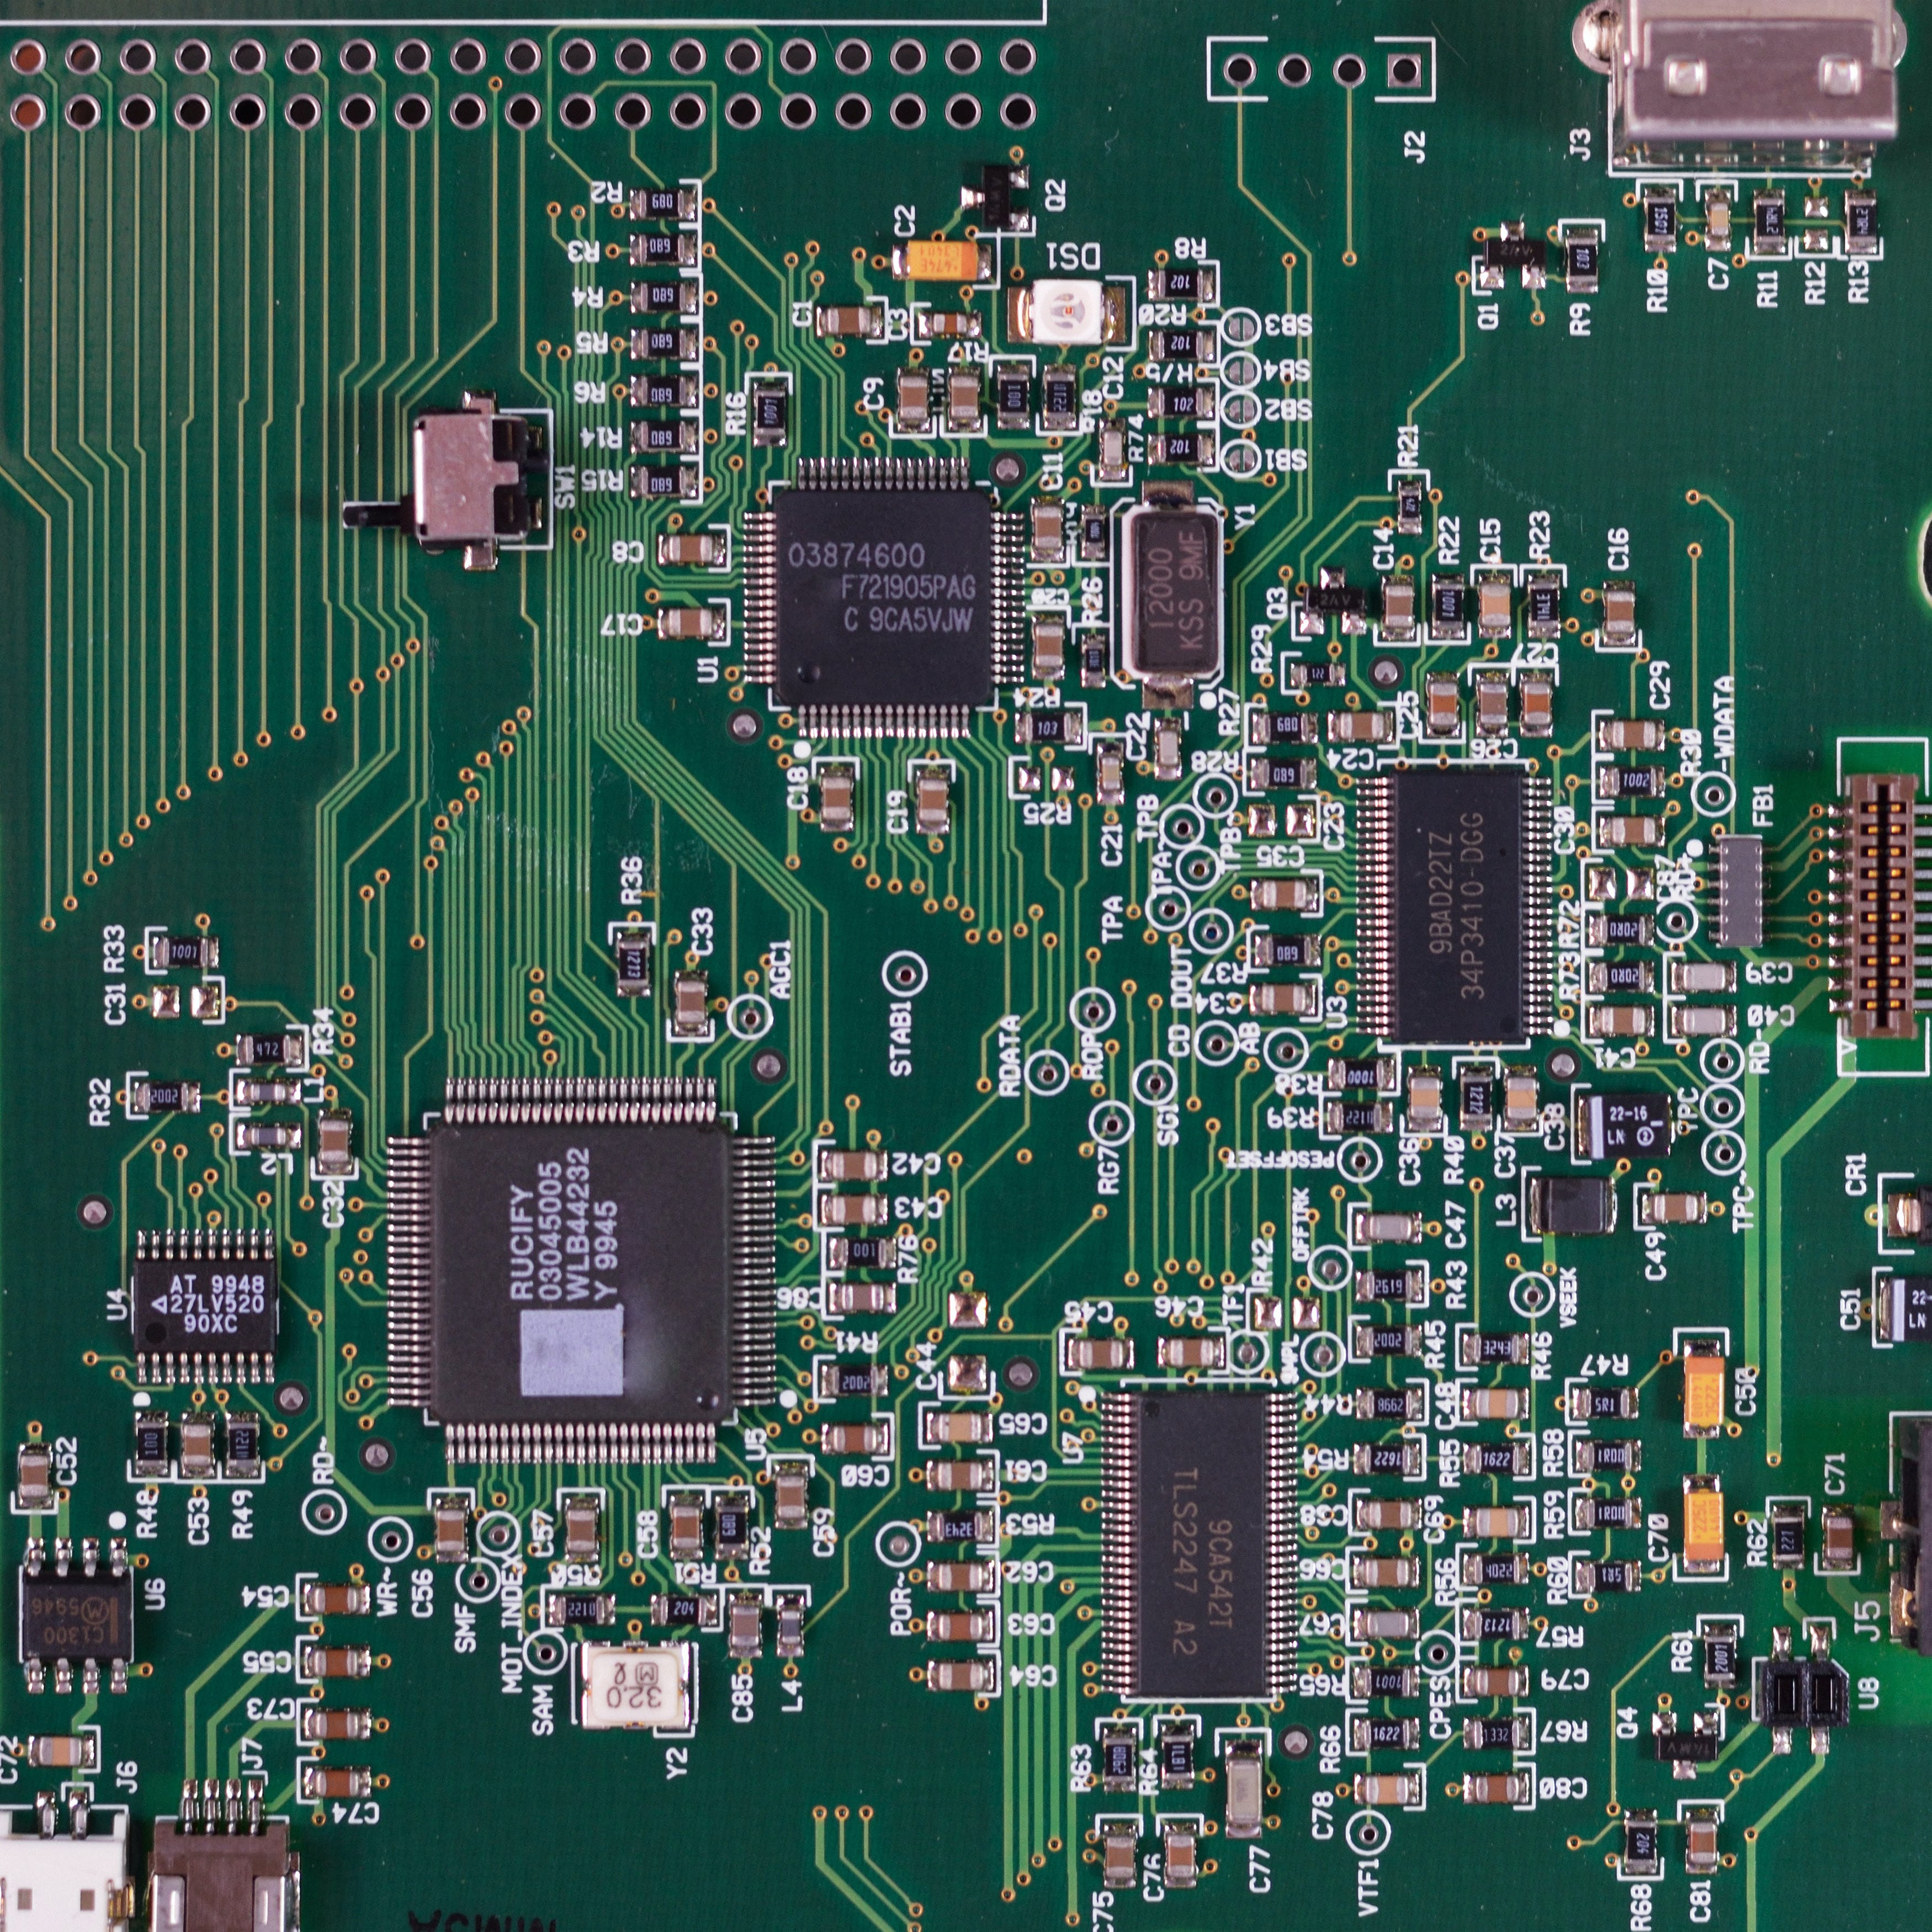
History of the AVR Microcontroller
The basic architecture was built by two students of NTH Alf & Vegard then bought and developed by Atmel in 1996. AVR stands for Alf-Vegard RISC (Reduced Instruction Set Computer)
Generally Classified in 4 groups
*Mega , Tiny , Special Purpose & Classic
AVR Features:
8 bit RISC single chip Microcontroller
Inbuilt ROM,RAM,EEPROM,timers,I/O ports
ADC,PWM,USB and so on

Slide 4
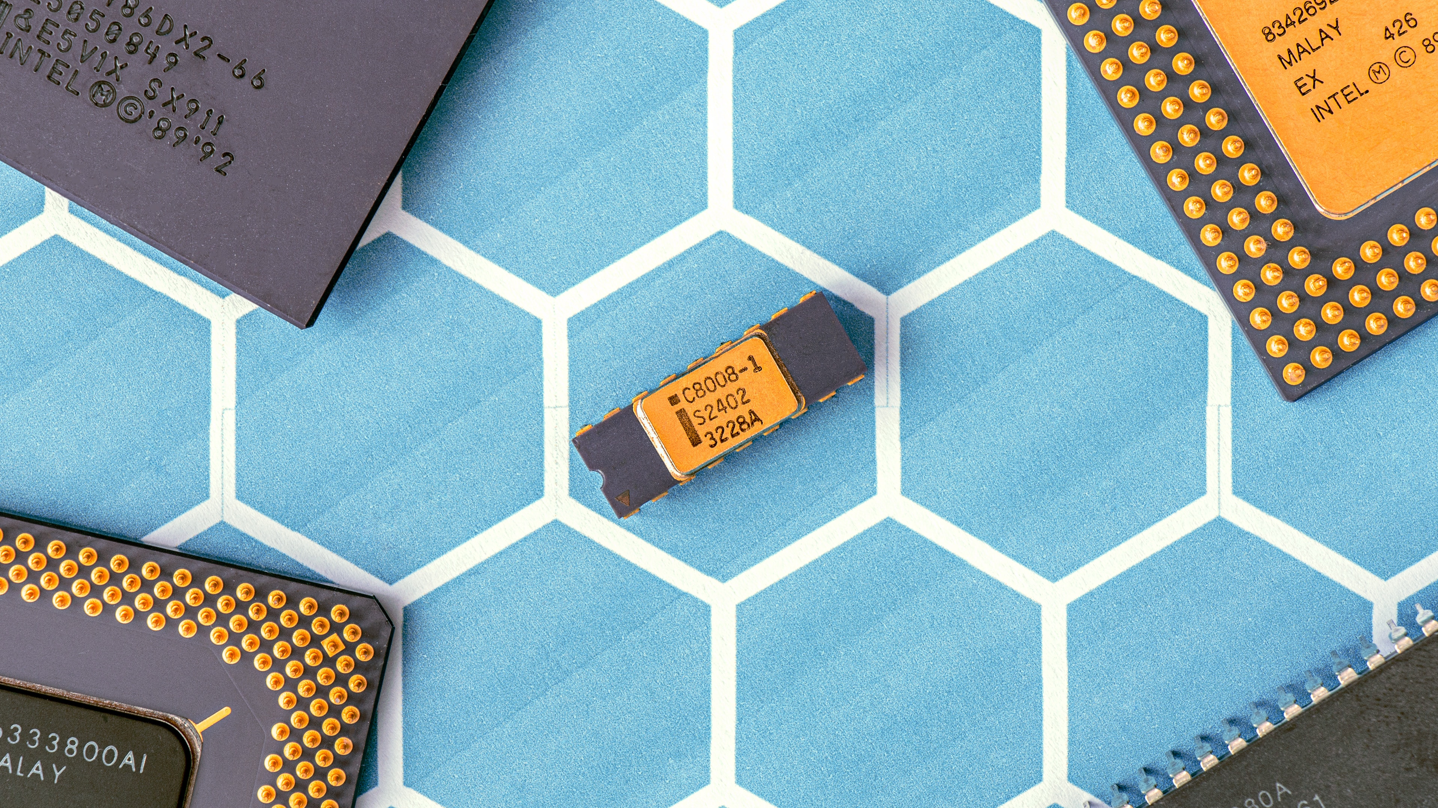
AVR Microcontroller Program ROM:
Has 8MB program code ROM space but can vary model to model. It is also the first microcontrollers to use on-chip Flash memory for program memory. It’s ideal for fast development cause it can be erased in seconds compared to 20 minutes or more needed by UV-EPROM
AVR Microcontroller data RAM & EEPROM:
RAM is for data storage.AVR has a maximum 64kb of data RAM storage.It has 3 components:
General-purpose registers [ 32 ]
I/O memory [ varies from chip to chip ]
Internal SRAM [ varies from chip to chip ]
AVR Microcontroller I/O Pins:
It can have 3 to 86 pins for I/O. Total number of pins for the AVR package goes from 8 to 100.
8 pin AT90S2323 has 3 pins for I/O
100 pin ATmega1280 has 86 pins for I/O
Peripherals: Most of the AVRs come with ADC (Analog to Digital Converter),Timers,USART(Universal Synchronous Asynchronous Receiver Transmitter)

Slide 5

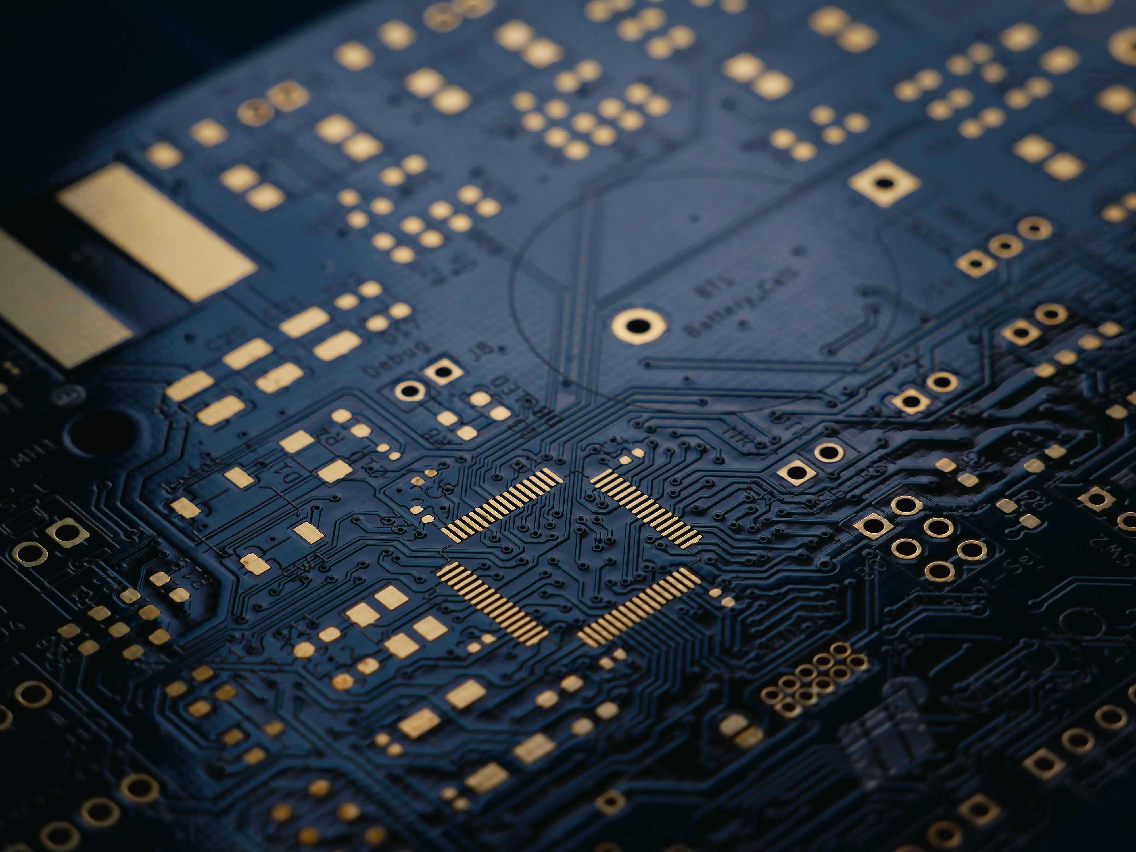
AVR family overview:
Classic >> This is original AVR chip later replaced by the new ones. Example: AT90S2313,AT90S2323 etc.
Mega >> These are powerful and have more than 120 instructions, lots of different peripherals. Example: ATmega8, ATmega16, ATmega32, ATmega64, ATmega1280 etc.
Tiny >> As named it has less instructions , less peripherals compared to Mega. Example: ATtiny13,ATtiny25,ATtiny44 etc.
Special Purpose >> IC’s of this group can be considered as subset of other groups.Yet they have special capabilities like : USB controller,CAN controller,LCD controller etc. Example: AT90CAN128,AT90USB1287 etc.
Other Microcontrollers: There are other Microcontrollers made by Atmel,Microchip,Intel,Zilog etc. For comprehensive treatment of them see “The 8051 Microcontroller & Embedded systems”,”PIC Microcontrollers & Embedded systems” by Mazidi.
Thank You

Slide 6
AVR family overview:
Classic >> This is original AVR chip later replaced by the new ones. Example: AT90S2313,AT90S2323 etc.
Mega >> These are powerful and have more than 120 instructions, lots of different peripherals. Example: ATmega8, ATmega16, ATmega32, ATmega64, ATmega1280 etc.
Tiny >> As named it has less instructions , less peripherals compared to Mega. Example: ATtiny13,ATtiny25,ATtiny44 etc.
Special Purpose >> IC’s of this group can be considered as subset of other groups.Yet they have special capabilities like : USB controller,CAN controller,LCD controller etc. Example: AT90CAN128,AT90USB1287 etc.
Thank You
Other Microcontrollers: There are other Microcontrollers made by Atmel,Microchip,Intel,Zilog etc. For comprehensive treatment of them see “The 8051 Microcontroller & Embedded systems”,”PIC Microcontrollers & Embedded systems” by Mazidi.

